Slide 1

Online E-Book System
Batch code [2104b1]
3rd semester: hdse-i
Presented by:
Our Team Members: Furqan, Hassan, Wahaj & Farzam.
Notes:
This template can be used as a starter file for presenting training materials in a group setting.
Sections
Right-click on a slide to add sections. Sections can help to organize your slides or facilitate collaboration between multiple authors.
Notes
Use the Notes section for delivery notes or to provide additional details for the audience. View these notes in Presentation View during your presentation.
Keep in mind the font size (important for accessibility, visibility, videotaping, and online production)
Coordinated colors
Pay particular attention to the graphs, charts, and text boxes.
Consider that attendees will print in black and white or grayscale. Run a test print to make sure your colors work when printed in pure black and white and grayscale.
Graphics, tables, and graphs
Keep it simple: If possible, use consistent, non-distracting styles and colors.
Label all graphs and tables.

Slide 2
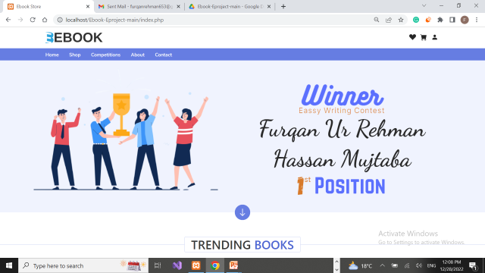
Introduction? Our E-Book Online System is one of the best Online Books Platform where anyone can buy books in three forms: PDF, Hard Copy & CD & new trending books are also available here with reasonable prize. We are Publishers of Our E-Books, that also conduct the Competitions on Essay Writing and Story Writing on any topic.
Our Home Page:-
Notes:
Give a brief overview of the presentation. Describe the major focus of the presentation and why it is important.
Introduce each of the major topics.
To provide a road map for the audience, you can repeat this Overview slide throughout the presentation, highlighting the particular topic you will discuss next.

Slide 3

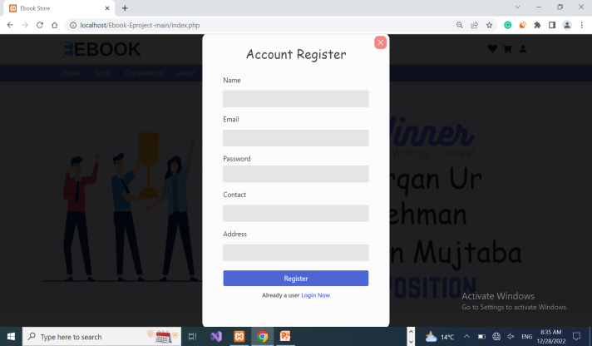
Registration Page:
User can register yourself with our website, so that they can buy books as they desire.
Notes:
This is another option for an Overview slides using transitions.

Slide 4
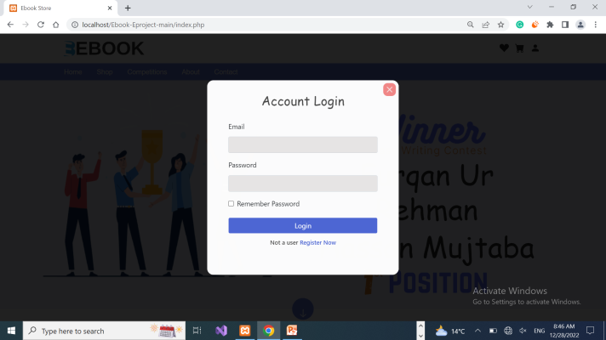
Login Page:
After registration, user must be login with the site to buy books that depend on various categories and also can participate in competitions.
Notes:
This is another option for an Overview slides using transitions.

Slide 5
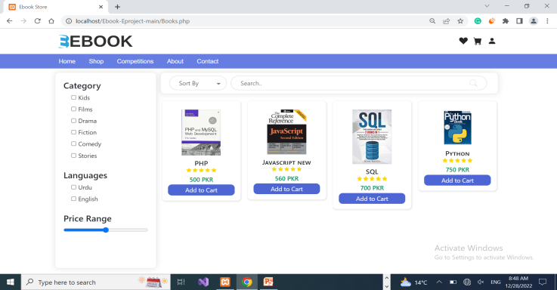
Shop Page:
In this page, user can add to cart books which he/she want to buy.
After clicking any book, that book add into add to cart.

Slide 6
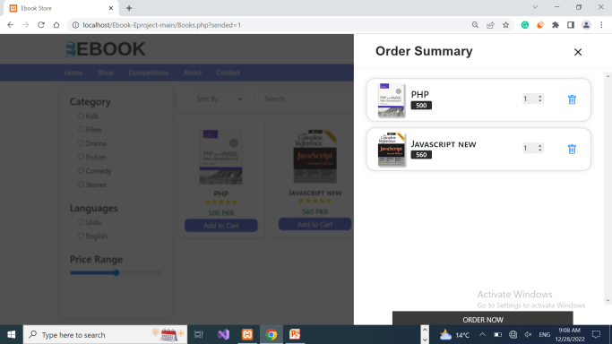
Add to Cart Page:
After Clicking Add to Cart button, the book is added into cart page, which is shown below.

Slide 7
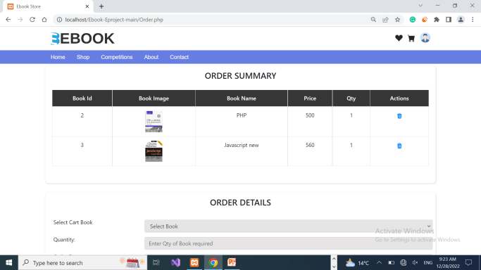

Confirm Order Page:
Now Customer can confirm your order(s) or delete any order(s), after confirmation his/her invoice is generated as per no. of orders.
Below, Order details are comprising on delivery location, delivery charges, weight of the book and their charges; weight of the book depends on book type (Hard Copy).

Slide 8
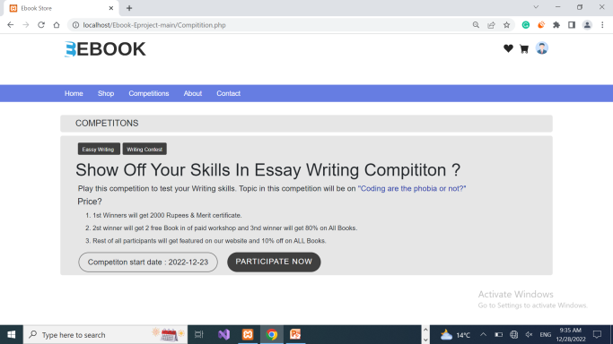
a) Competitions Page:
If User wants to participate in competitions, he/she clicks on competitions, where current competition details and its commencement date as well as its topics and prizes will be shown which are as under.

Slide 9

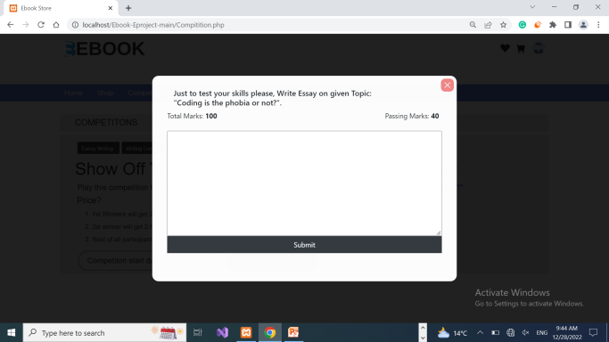
b) Competitions Page:
After clicking on Participate now button, this below page will be appear, where user can see the topics of essay with total marks as well as passing marks that he/she will score.

Slide 10
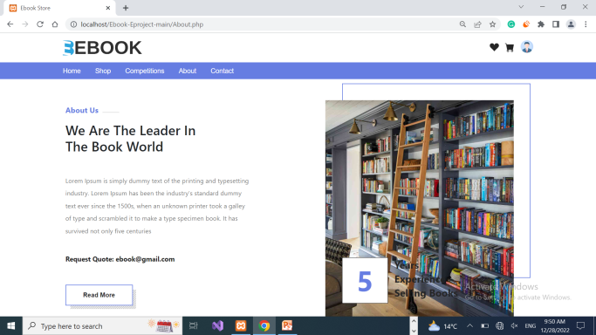
About Page:
User can know about our website through this, our goals, our achievements and so on.

Slide 11
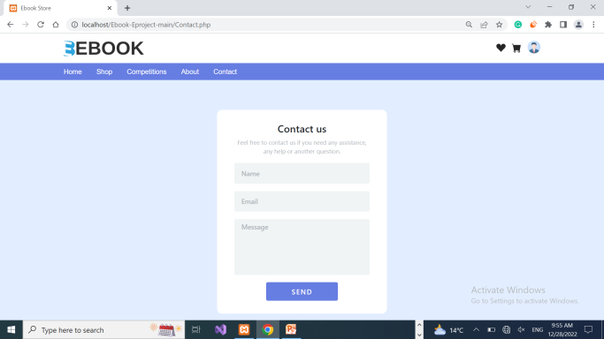
Contact Page:
For any query, User/Customer can contact us through this page, so that we could redressed their grievances on top priority basis.

Slide 12
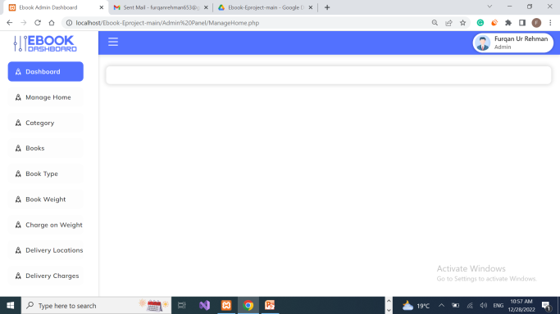
Admin Dashboard:
Only Admin can access this page, where he/she can manage the website’s components i.e. Book Category, Add Books, Book type etc. Here we will show some Admin’s sections.

Slide 13
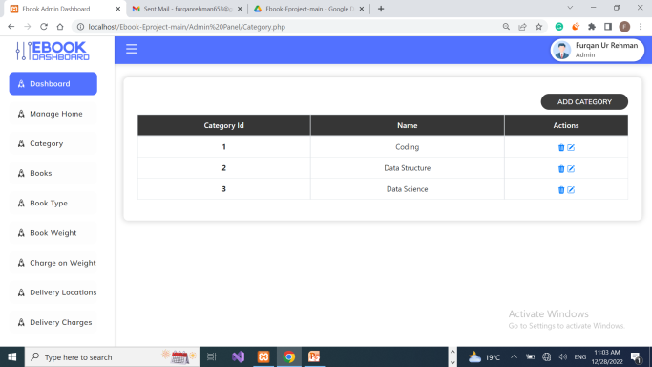
Manage Category:
Admin can View, Add and delete books category.

Slide 14
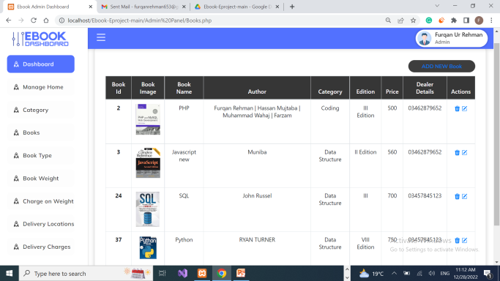
Manage Books:
Admin can Add new books that is in hand also View, Edit and Delete Books.

Slide 15

Manage Books Types:
Further, Admin can Add new book types(PDF, Hard Copy, CD) also View, and Delete Books types.

Slide 16
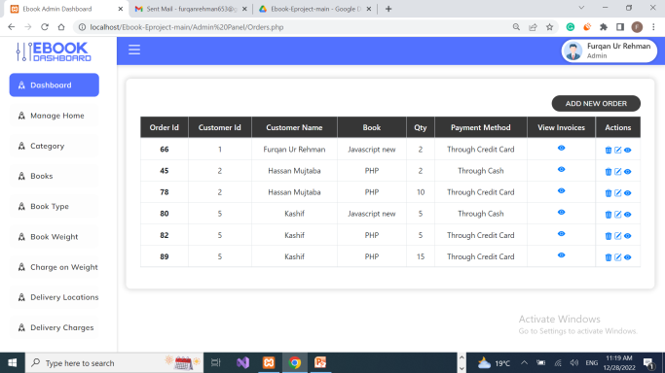
Manage Orders:
Further, Admin can Add new customer’s order by requesting customer also View, and Delete orders.

Slide 17
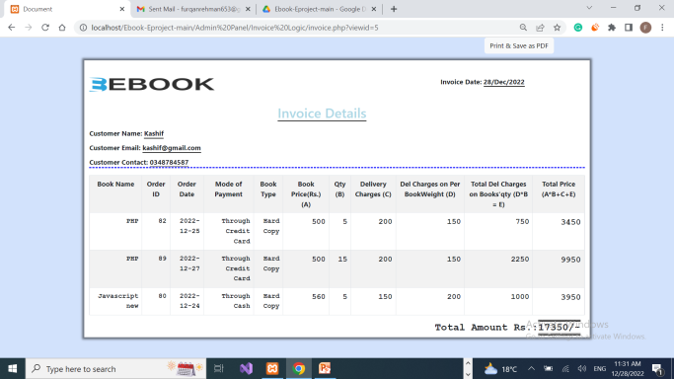
Manage Invoices:
Moreover, Invoice is generated automatically when an order is confirmed by User/Customer. And Admin can view his/her invoice and send to customer via Gmail.

Slide 18
Summary
We studied following pages:
Home.
Login & Registration.
Shop & Competitions.
Add to Cart and Confirm Orders.
About and Contact.
Some Admin Sections.
Notes:
Summarize presentation content by restating the important points from the lessons.
What do you want the audience to remember when they leave your presentation?
Save your presentation to a video for easy distribution (To create a video, click the File tab, and then click Share. Under File Types, click Create a Video.)

Slide 19
Thanks for watching…
The End…
Notes:
Is your presentation as crisp as possible? Consider moving extra content to the appendix.
Use appendix slides to store content that you might want to refer to during the Question slide or that may be useful for attendees to investigate deeper in the future.

